Slide 1
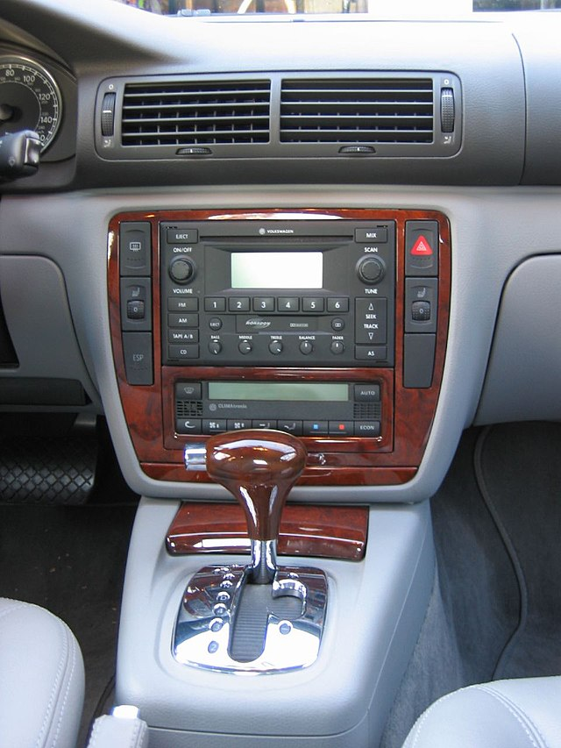
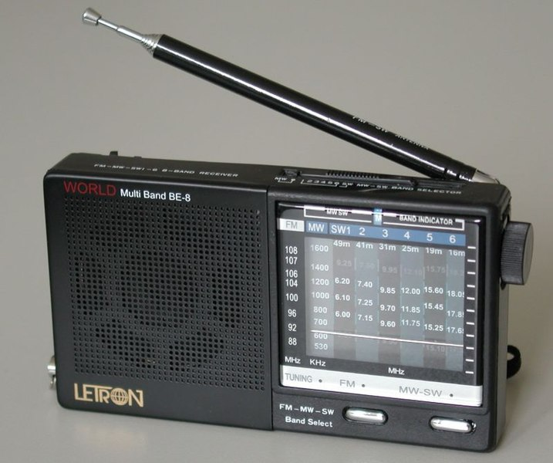
Think About Radio
With an elbow partner
How do you think your radio “catches” sounds from far?
Notes:
Image source: https://upload.wikimedia.org/wikipedia/commons/thumb/f/f3/Radio.jpg/717px-Radio.jpg

Slide 2
Explore Radio Signals
With your class
Go to the simulation (tinyurl.com/bddepdbk)
How does the motion of the electron on the first pole/antenna when we:
increase the frequency ?
increase the amplitude ?

Slide 3
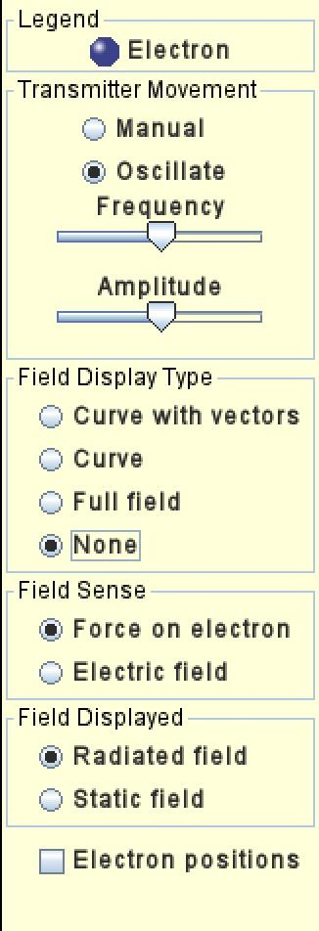
Explore Radio Signals
On your own
Go to this simulation (tinyurl.com/bddepdbk)
Use the simulation to answer the following questions:
If we change the frequency of the electron of the first antenna, what happens to the electron on the second antenna?
If we change the amplitude of the electron of the first antenna, what happens to the electron on the second antenna?

Slide 4
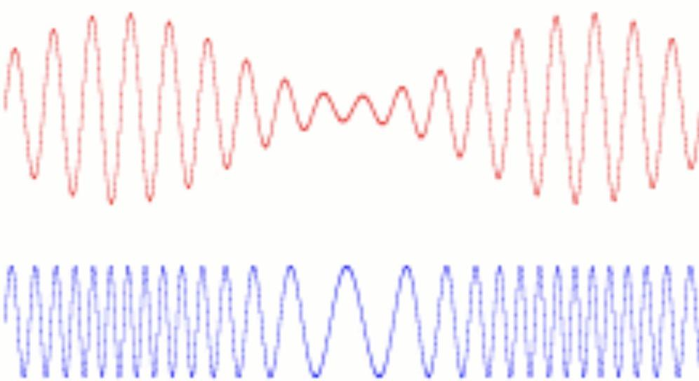
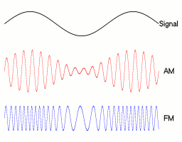
AM and FM radio
Amplitude Modulation
AM
How does the wave change in each case?
AM
Frequency Modulation
FM
FM

Slide 5
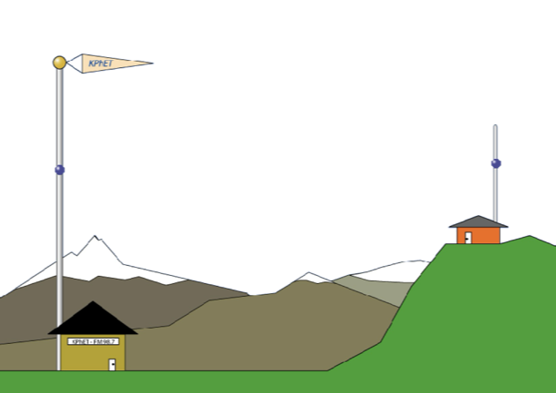
AM and FM radio
With a partner
How would the electron on the receiving antenna move in each case?
AM
FM

Slide 6
Think About Radio
On your own
Complete the reading to learn how radios turn waves into music.

